Slide 1
Linear regression
Session1 (Refresher):
comparison of means and correlation
MPH 2022-2023

Slide 2
Session 1: Correlation, T-test and ANOVA
Correlation coefficient
ANOVA
Within group variation
Between group variation
Total variation
Sum of squares
Variance
Standard deviation
T-test
F-test
Notes:
The term “multiple” in “multiple regression” is explained by the fact that the number of independent variables in the model is larger than 1.
The analysis of variance will help us to determine the “goodness of fit”, the technical term for what might also be called “precision” of the model. It will clarify the role of each variable, and help to decide which variable(s) to put into the model, taking the principle of parsimony into account.
We shall see that a strategy is needed to define the most appropriate order by which terms are introduced into the model.
See further!

Slide 3
Relation between a continuous and a categorical variable

Slide 4
Height (cm) and Ethnicity, an independent variable with only two levels
Asian | European
166 | 168
168 | 170
168 | 170
170 | 172
170 | 172
170 | 172
172 | 174
172 | 174
174 | 176

Slide 5
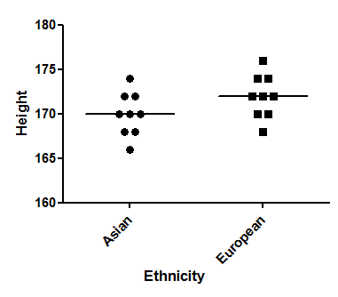
Is there a statistically significant difference in mean height between UK men of Asian and of European origin? (n=18)

Slide 6
T-test in R
Command : t.test(Height~Asian, alternative='two.sided’, conf.level=.95, var.equal=TRUE, data=Lesson1)
Two Sample t-test
data: Height by Asian
t = 1.7321, df = 16, p-value = 0.1025
alternative hypothesis: true difference in means is not equal to 0
95 percent confidence interval: -0.4478558 4.4478558
sample estimates:
mean in group European mean in group Asian
172 170

Slide 7
T-test in R
Command : t.test(Height~Asian, alternative='two.sided’, conf.level=.95, var.equal=TRUE, data=Lesson1)
Two Sample t-test
data: Height by Asian
t = 1.7321, df = 16, p-value = 0.1025
alternative hypothesis: true difference in means is not equal to 0
95 percent confidence interval: -0.4478558 4.4478558
sample estimates:
mean in group European mean in group Asian
172 170

Slide 8
Within group variance
Asian | (x-mean)^2 |  | European | (x-mean)^2
166 |  |  | 168
168 |  |  | 170
168 |  |  | 170
170 |  |  | 172
170 |  |  | 172
170 |  |  | 172
172 |  |  | 174
172 |  |  | 174
174 |  |  | 176
Sum of squares |  |  | Sum of squares

Slide 9
Within group variance
Asian | (x-mean)^2 |  | European | (x-mean)^2
166 | (166-170)^2=16 |  | 168
168 | (168-170)^2=4 |  | 170
168 | (168-170)^2=4 |  | 170
170 | (170-170)^2=0 |  | 172
170 | (170-170)^2=0 |  | 172
170 | (170-170)^2=0 |  | 172
172 | (172-170)^2=4 |  | 174
172 | (172-170)^2=4 |  | 174
174 | (174-170)^2=16 |  | 176
Sum of squares |  |  | Sum of squares

Slide 10
Within group variance
Asian | (x-mean)^2 |  | European | (x-mean)^2
166 | (166-170)^2=16 |  | 168
168 | (168-170)^2=4 |  | 170
168 | (168-170)^2=4 |  | 170
170 | (170-170)^2=0 |  | 172
170 | (170-170)^2=0 |  | 172
170 | (170-170)^2=0 |  | 172
172 | (172-170)^2=4 |  | 174
172 | (172-170)^2=4 |  | 174
174 | (174-170)^2=16 |  | 176
Sum of squares | 16+4+4+4+4+16=48 |  | Sum of squares

Slide 11
Within group variance
Asian | (x-mean)^2 |  | European | (x-mean)^2
166 | (166-170)^2=16 |  | 168 | (168-172)^2=16
168 | (168-170)^2=4 |  | 170 | (170-172)^2=4
168 | (168-170)^2=4 |  | 170 | (170-172)^2=4
170 | (170-170)^2=0 |  | 172 | (172-172)^2=0
170 | (170-170)^2=0 |  | 172 | (172-172)^2=0
170 | (170-170)^2=0 |  | 172 | (172-172)^2=0
172 | (172-170)^2=4 |  | 174 | (174-172)^2=4
172 | (172-170)^2=4 |  | 174 | (174-172)^2=4
174 | (174-170)^2=16 |  | 176 | (176-172)^2=16
Sum of squares | 16+4+4+4+4+16=48 |  | Sum of squares | 16+4+4+4+4+16=48
48+48=96

Slide 12
Total variance
Asian | (x-mean)^2 |  | European | (x-mean)^2
166 |  |  | 168
168 |  |  | 170
168 |  |  | 170
170 |  |  | 172
170 |  |  | 172
170 |  |  | 172
172 |  |  | 174
172 |  |  | 174
174 |  |  | 176
Sum of squares |  |  | Sum of squares

Slide 13
Total variance
Asian | (x-mean)^2 |  | European | (x-mean)^2
166 | (166-171)^2=25 |  | 168 | (168-171)^2=9
168 | (168-171)^2=9 |  | 170 | (170-171)^2=1
168 | (168-171)^2=9 |  | 170 | (170-171)^2=1
170 | (170-171)^2=1 |  | 172 | (172-171)^2=1
170 | (170-171)^2=1 |  | 172 | (172-171)^2=1
170 | (170-171)^2=1 |  | 172 | (172-171)^2=1
172 | (172-171)^2=1 |  | 174 | (174-171)^2=9
172 | (172-171)^2=1 |  | 174 | (174-171)^2=9
174 | (174-171)^2=9 |  | 176 | (176-171)^2=25
Sum of squares | 25+9+9+1+1 +1+1+9=57 |  | Sum of squares | 9+1+1+1+1 +9+9+25=57
57+57=114

Slide 14
T-test
t = 1.7321, df = 16, p-value = 0.1025
Variation | SS | df | MS | F statistic
Between | 18.0000 | 1 | 18.0000 | 3.0000
Within | 96.0000 | 16 | 6.0000
Total | 114.0000 | 17
T Statistic = 1.7321
P-value = 0.1025
MS = SS/df
2 groups => 2-1 df
18 observations =>
18-1 df
2 groups of 9 =>
(9-1) + (9-1) df

Slide 15
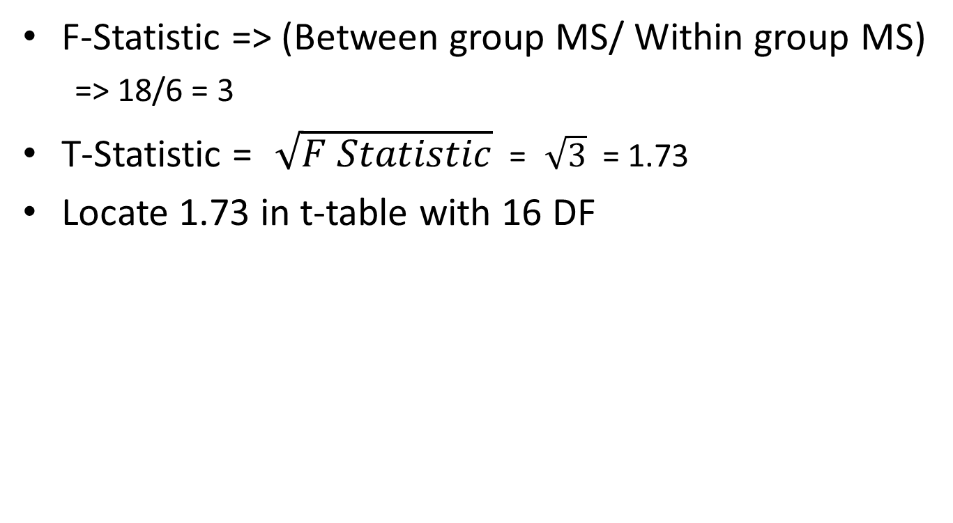
T-statistic

Slide 16
Critical Values of Student's t
.10 .05 .025 .01 .005 .0005 1-tail
df .20 .10 .050 .02 .010 .0010 2-tail
1 3.078 6.314 12.706 31.821 63.657 636.619
2 1.886 2.920 4.303 6.965 9.925 31.599
3 1.638 2.353 3.182 4.541 5.841 12.924
4 1.533 2.132 2.776 3.747 4.604 8.610
5 1.476 2.015 2.571 3.365 4.032 6.869
6 1.440 1.943 2.447 3.143 3.707 5.959
16 1.337 1.746 2.120 2.583 2.921 4.015
17 1.333 1.740 2.110 2.567 2.898 3.965
18 1.330 1.734 2.101 2.552 2.878 3.922
19 1.328 1.729 2.093 2.539 2.861 3.883
20 1.325 1.725 2.086 2.528 2.845 3.850
21 1.323 1.721 2.080 2.518 2.831 3.819
22 1.321 1.717 2.074 2.508 2.819 3.792
23 1.319 1.714 2.069 2.500 2.807 3.768
24 1.318 1.711 2.064 2.492 2.797 3.745

Slide 17
Critical Values of Student's t
.10 .05 .025 .01 .005 .0005 1-tail
df .20 .10 .050 .02 .010 .0010 2-tail
1 3.078 6.314 12.706 31.821 63.657 636.619
2 1.886 2.920 4.303 6.965 9.925 31.599
3 1.638 2.353 3.182 4.541 5.841 12.924
4 1.533 2.132 2.776 3.747 4.604 8.610
5 1.476 2.015 2.571 3.365 4.032 6.869
6 1.440 1.943 2.447 3.143 3.707 5.959
16 1.337 1.746 2.120 2.583 2.921 4.015
17 1.333 1.740 2.110 2.567 2.898 3.965
18 1.330 1.734 2.101 2.552 2.878 3.922
19 1.328 1.729 2.093 2.539 2.861 3.883
20 1.325 1.725 2.086 2.528 2.845 3.850
21 1.323 1.721 2.080 2.518 2.831 3.819
22 1.321 1.717 2.074 2.508 2.819 3.792
23 1.319 1.714 2.069 2.500 2.807 3.768
24 1.318 1.711 2.064 2.492 2.797 3.745

Slide 18
The concept of variance
Total variance
Within groups
Between groups

Slide 19
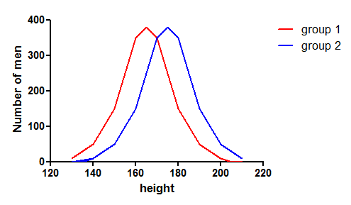
Within group and total variance Between group variance = total variance – within group variance

Slide 20
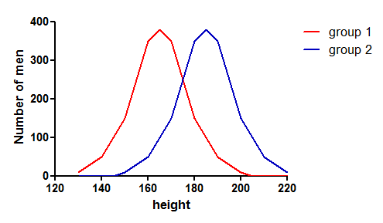
Within group and total variance Between group variance = total variance – within group variance

Slide 21
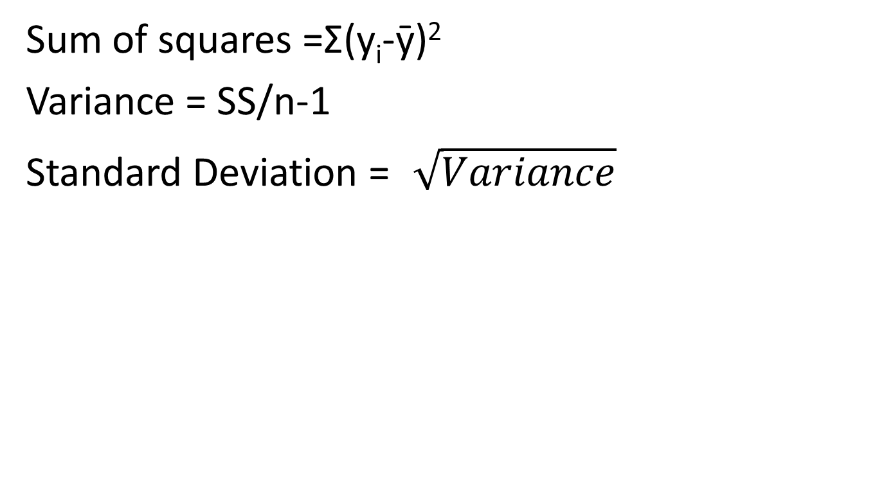
Sum of Squares, Variance and Standard Deviation
Height
171
172
173
172

Slide 22
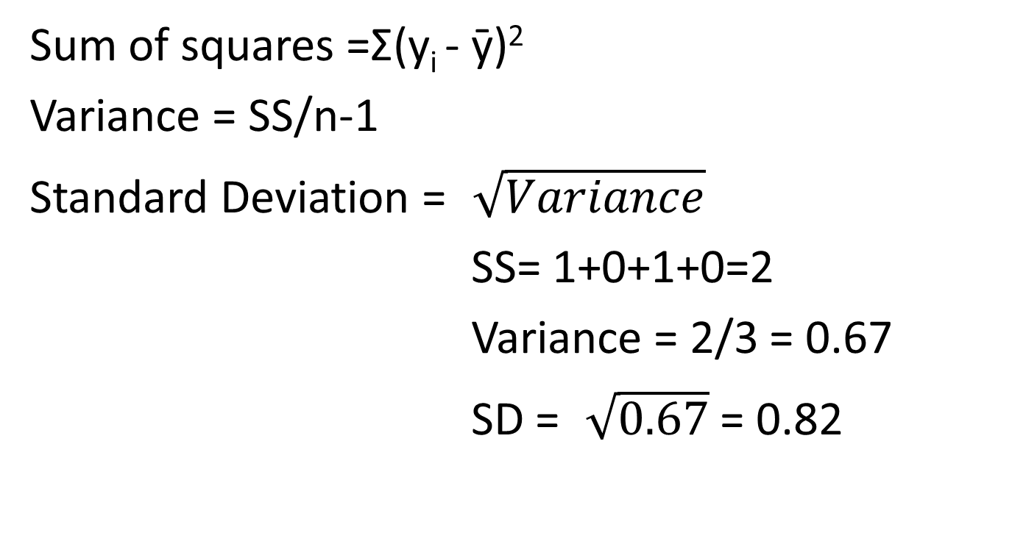
Sum of Squares, Variance and Standard Deviation
HEIGHT | (y_{i} - ӯ)²
171 | (171-172)²
172 | (172-172)²
173 | (173-172)²
172 | (172-172)²

Slide 23
Conditions for T-test
Normal distribution or large sample size (>100 per group) and unimodal distribution
Homogeneity of group variances

Slide 24
Conditions for T-test
tapply(Lesson1$Height, Lesson1$Asian, var)
bartlett.test(Height ~ Asian, data=Lesson1)
Bartlett test of homogeneity of variances
data: Height by Asian
Bartlett's K-squared = 0, df = 1, p-value = 1

Slide 25
Conditions for T-test
library(sm)
sm.density.compare(Lesson1$Height, Lesson1$Asian)

Slide 26
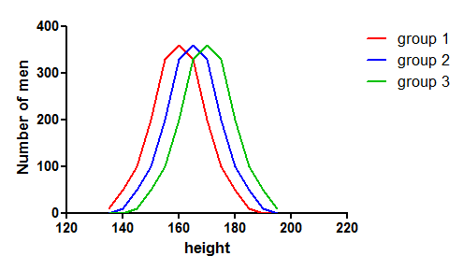
An independent variable with more than 2 levels : ANOVA

Slide 27
ANOVA
Is there a statistically significant difference in mean height between the 3 groups?
Null hypothesis: μ height group 1 = μ height group 2 = μ height group 3

Slide 28
ANOVA
Height
Group1 |  | Group2 |  | Group3
171 |  | 173 |  | 175
172 |  | 174 |  | 176
172 |  | 174 |  | 176
173 |  | 175 |  | 177
Overall mean = 174 cm
Mean Group 1= 172 cm
Mean Group 2= 174 cm
Mean Group 3= 176 cm

Slide 29
Total sum of squares
Height
Group1 |  | Group2 |  | Group3
171 | (171-174)^2 | 173 | (173-174)^2 | 175 | (175-174)^2
172 | (172-174)^2 | 174 | (174-174)^2 | 176 | (176-174)^2
172 | (172-174)^2 | 174 | (174-174)^2 | 176 | (176-174)^2
173 | (173-174)^2 | 175 | (175-174)^2 | 177 | (177-174)^2
 | 9+4+4+1=18 |  | 1+0+0+1=2 |  | 1+4+4+9=18
Total sum of squares= 18 + 2 + 18 = 38

Slide 30
Within group sum of squares
Height
Group1 |  | Group2 |  | Group3
171 | (171-172)^2 | 173 | (174-174)^2 | 175 | (175-176)^2
172 | (172-172)^2 | 174 | (174-174)^2 | 176 | (176-176)^2
172 | (173-172)^2 | 174 | (174-174)^2 | 176 | (176-176)^2
173 | (172-172)^2 | 175 | (175-174)^2 | 177 | (177-176)^2
 | 1+0+0+1=2 |  | 1+0+0+1=2 |  | 1+0+0+1=2
Within group sum of squares= 2 + 2 + 2 = 6

Slide 31
ANOVA table
Source of variance | SS | df | MS | F
Between group
Within group | 6
Total | 38

Slide 32
ANOVA table
Source of variance | SS | df | MS | F
Between group | 32
Within group | 6
Total | 38

Slide 33
ANOVA table
Source of variance | SS | df | MS | F
Between group | 32 | 2
Within group | 6 | 9
Total | 38 | 11

Slide 34
ANOVA table
Source of variance | SS | df | MS | F
Between group | 32 | 2 | 16
Within group | 6 | 9 | 0.67
Total | 38 | 11
F = between group MS/within group MS

Slide 35
ANOVA table
Source of variance | SS | df | MS | F
Between group | 32 | 2 | 16 | 24
Within group | 6 | 9 | 0.67
Total | 38 | 11
F = between group MS/within group MS = 16/0.67=24

Slide 36
F-Table Critical values of F for alpha = 0.05
df | 1 | 2 | 3 | 4 | 5 | 6
1 | 161.45 | 199.5 | 215.71 | 224.58 | 230.16 | 233.99
2 | 18.51 | 19 | 19.16 | 19.25 | 19.3 | 19.33
3 | 10.13 | 9.55 | 9.28 | 9.12 | 9.01 | 8.94
4 | 7.71 | 6.94 | 6.59 | 6.39 | 6.26 | 6.16
5 | 6.61 | 5.79 | 5.41 | 5.19 | 5.05 | 4.95
6 | 5.99 | 5.14 | 4.76 | 4.53 | 4.39 | 4.28
7 | 5.59 | 4.74 | 4.35 | 4.12 | 3.97 | 3.87
8 | 5.32 | 4.46 | 4.07 | 3.84 | 3.69 | 3.58
9 | 5.12 | 4.26 | 3.86 | 3.63 | 3.48 | 3.37
10 | 4.96 | 4.1 | 3.71 | 3.48 | 3.33 | 3.22
11 | 4.84 | 3.98 | 3.59 | 3.36 | 3.2 | 3.09
12 | 4.75 | 3.89 | 3.49 | 3.26 | 3.11 | 3
13 | 4.67 | 3.81 | 3.41 | 3.18 | 3.03 | 2.92
14 | 4.6 | 3.74 | 3.34 | 3.11 | 2.96 | 2.85

Slide 37
F-Table Critical values of F for alpha = 0.05
df | 1 | 2 | 3 | 4 | 5 | 6
1 | 161.45 | 199.5 | 215.71 | 224.58 | 230.16 | 233.99
2 | 18.51 | 19 | 19.16 | 19.25 | 19.3 | 19.33
3 | 10.13 | 9.55 | 9.28 | 9.12 | 9.01 | 8.94
4 | 7.71 | 6.94 | 6.59 | 6.39 | 6.26 | 6.16
5 | 6.61 | 5.79 | 5.41 | 5.19 | 5.05 | 4.95
6 | 5.99 | 5.14 | 4.76 | 4.53 | 4.39 | 4.28
7 | 5.59 | 4.74 | 4.35 | 4.12 | 3.97 | 3.87
8 | 5.32 | 4.46 | 4.07 | 3.84 | 3.69 | 3.58
9 | 5.12 | 4.26 | 3.86 | 3.63 | 3.48 | 3.37
10 | 4.96 | 4.1 | 3.71 | 3.48 | 3.33 | 3.22
11 | 4.84 | 3.98 | 3.59 | 3.36 | 3.2 | 3.09
12 | 4.75 | 3.89 | 3.49 | 3.26 | 3.11 | 3
13 | 4.67 | 3.81 | 3.41 | 3.18 | 3.03 | 2.92
14 | 4.6 | 3.74 | 3.34 | 3.11 | 2.96 | 2.85

Slide 38
Conclusion
F = 24,
Critical value for p=0.05, df (2,9) = 4.26
p< 0.05
We reject the null hypothesis

Slide 39
Conditions for ANOVA
Normal distribution
Homogeneity of group variances

Slide 40
R Output Anova
> AnovaModel.1 <- aov(Height ~ Group, data=Lesson1_2)
> summary(AnovaModel.4)
Df Sum Sq Mean Sq F value Pr(>F)
Group 2 32 16.000 24 0.000247 ***
Residuals 9 6 0.667
---
Signif. codes: 0 '***' 0.001 '**' 0.01 '*' 0.05 '.' 0.1 ' ' 1
> tapply(Lesson1_2$Height, Lesson1_2$Group, mean)
1 2 3
172 174 176
> tapply(Lesson1_2$Height, Lesson1_2$Group, sd)
1 2 3
0.8164966 0.8164966 0.8164966

Slide 41
R Output Equality of variances
tapply(Lesson1_2$Height, Lesson1_2$Group, var)
bartlett.test(Height ~ Group, data=Lesson1_2)
Bartlett test of homogeneity of variances
data: Height by Group
Bartlett's K-squared = 0, df = 2, p-value = 1

Slide 42
R Output (remove this slide???) Normal distribution
hist(Lesson1_2$Height[Lesson1_2$Group == 1], xlim=range(Lesson1_2$Height))
hist(Lesson1_2$Height[Lesson1_2$Group == 2], xlim=range(Lesson1_2$Height))
hist(Lesson1_2$Height[Lesson1_2$Group == 3], xlim=range(Lesson1_2$Height))

Slide 43
R Output Normal distribution
library(sm)
sm.density.compare(Lesson1_2$Height, Lesson1_2$Group)

Slide 44
Relation between 2 continuous variables
Two methods:
Correlation: to assess whether the two variables are associated, characterize strength of association with a number (correlation coefficient)
Regression: to describe how one variable depends on the other(s), to predict one variable from the other variable(s)
Notes:
Often we are interested in the relation between to variables, e.g. height and weight, cancer and cigarette consumption, cholesterol and age etc. There are two techniques with distinct purposes, correlation and regression.

Slide 45
Scatter plot:
Notes:
<scatter plot>
The appropriate graphical presentation for these type of data is a scatter diagram. There appears to be some association between the values of the two variables; we can see that there is a tendency for the older people to have a higher cholesterol level.

Slide 46
What we know already:
Pearson coefficient of correlation r
-1 < r < 1: if close to -1 or 1: strong linear correlation
Strength of linear relation, direction of association
Notes:
If we want to measure the degree of association, this can be done by calculating the correlation coefficient. The standard method leads to a coefficient called r which can take any value from -1 to +1. This correlation coefficient r measures the strength of the linear relation between the values of the two variables.
Thus a value of +1 or -1 is obtained if all the points in the scatter diagram lie on a perfect straight line. A correlation of around zero indicates that there is no linear relation between the values of the two variables (i.e. they are uncorrelated).
The correlation coefficient also gives information on the direction of the association. The correlation coefficient is positive if higher values of one variable are associated with higher values of the other and negative if one variable tends to be lower as the other gets higher.

Slide 47
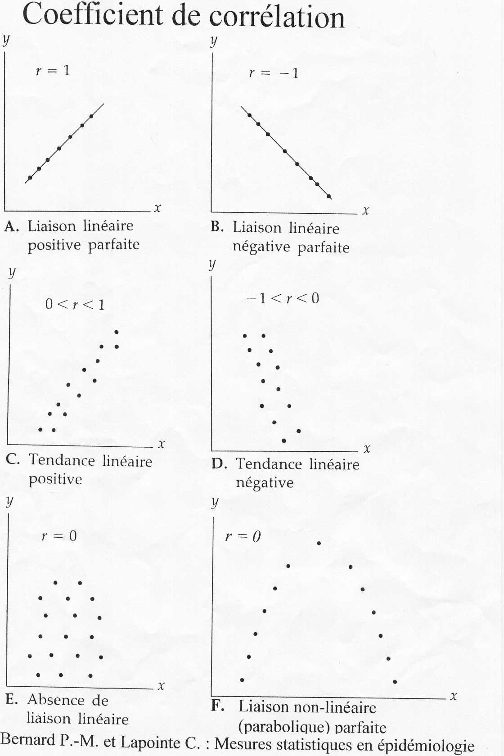
Notes:
<6 scatter plots with correlation coefficients>
Different scatterplots with acc. correlation coefficients.

Slide 48
Strength of correlation
Direction of relationship does not affect its strength!
|0.00| < r ≤ |0.25|: little if any
|0.26| < r ≤ |0.49|: low
|0.50| < r ≤ |0.69|: moderate
|0.70| < r ≤ |0.89|: high
|0.90| < r ≤ |1.00|: very high
Interpretation depends on context!
Notes:
For the interpretation of the correlation coefficient r, the context is important. An association between certain biological parameters can be required to be high as r = 0.90 to be considered as important. For behavioural patterns, however, a correlation of r = 0.50 could be deemed to be quite high, given the complex nature of the issue.

Slide 49
r = 0.9075
Notes:
Clearly the variables in this figure are positively correlated; in fact the correlation coefficient can be calculated to be r = 0.9075.

Slide 50
…what we’ve learnt so far:
Variance
Within group variation
Between group variation
Total variation
Sum of squares
ANOVA table
Standard deviation
T-test
F-test
Correlation coefficient

